Slide 1
Sales Analysis
Ali Kharabsheh

Slide 2
Overview
Category | Type | Insights | Inference
Product Behaviour | Product sales against time | Towards the end of the year, we see a peak in sales for all of the products | This could be due to the sales that happens at the end of each year (Black Friday, Christmas, … etc)
Market Opportunity | Predictions for future sales | There are 42 states that do not have any sales, they can be targeted to gain customers in these states | _______

Slide 3
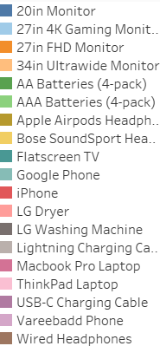
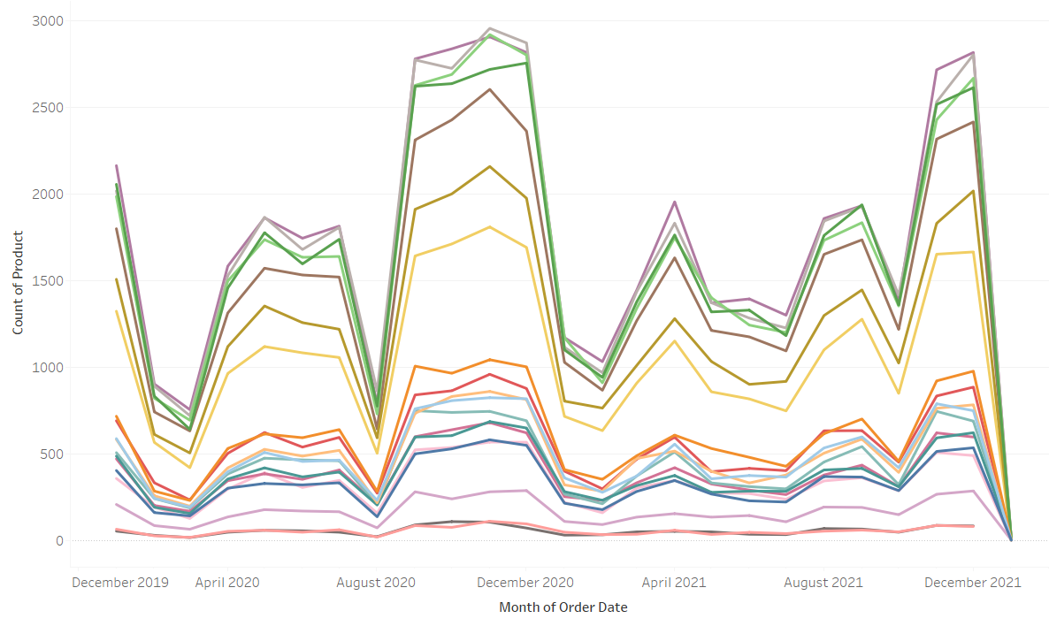
Products Sales Trends(using tableau analyse)
Towards the end of the year, we see a peak in sales for all of the products.

Slide 4
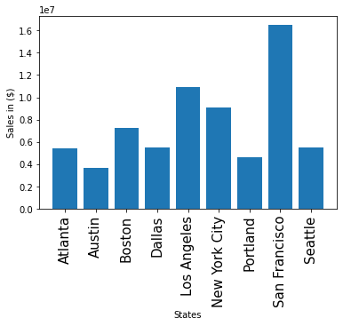
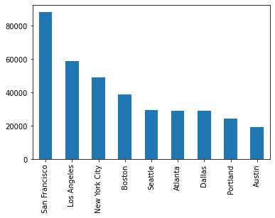
Sales in the States
San Francisco have the most sales compared to all other states.

Slide 5
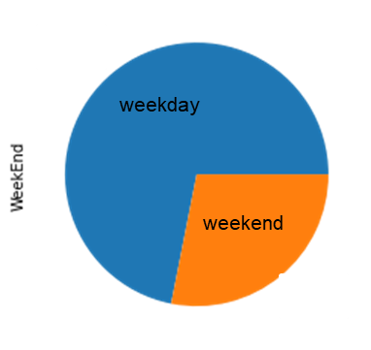
Sales percentage in Weekend and weekday
The number of sales per weekday is 263623
The number of sales per weekend is 103107
The percentage of sales per weekday is 61 %
The percentage of sales per weekend is 39 %

Slide 6
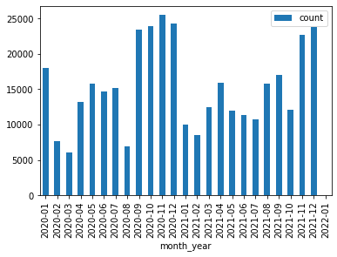
Getting the number of products in each month of the years
Towards the end of the year, we see a peak in sales for all of the products
This could be due to the sales that happens at the end of each year (Black Friday, Christmas, … etc.

Slide 7
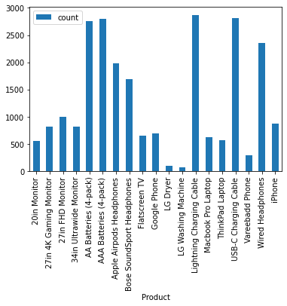
Find the best-selling and least-selling product in a particular month of the year(like 2020-12)
highest product sales is: Lightning Charging Cable(count: 2870)
minimum product sales is: LG Washing Machine(count: 71)

Slide 8
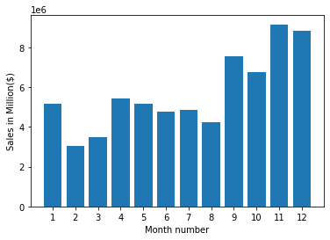
Getting the best month for sales
Towards the end of the year, we see a peak in sales for all of the products
This could be due to the sales that happens at the end of each year (Black Friday, Christmas, … etc.

Slide 9
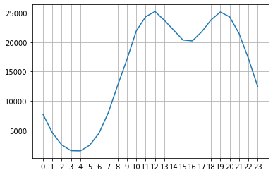
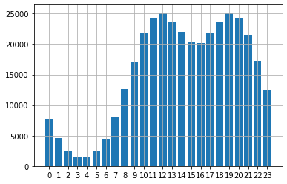
finding the hour should we display advertisements to maximize the likelihood of customers buying the product
maximum of buying the products was at 12:00 pm or 7:00 pm

Slide 10
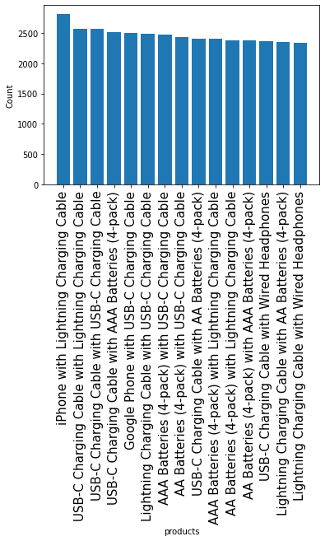
Finding the products are most often sold together

Slide 11
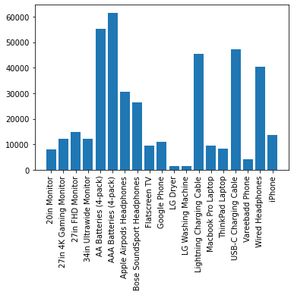
Getting product sold the most

Slide 12
The End

